Slide 1
WELCOME! ATHNA’s VIRTUAL BOOK LAUNCH PARTY
Glad you are joining us via Zoom.
If you experience technical difficulties during the event, please try to reboot.
If we experience any technical difficulties during the event, we will send you a Constant Contact message that either says: Please standby or Here is a new Zoom Link.
Hopefully, there will be no technical glitches for you or us!
The program is planned to run for one hour. Slides will be posted on Monday on www.athna.org.
Please keep yourself muted at all times, so everyone can hear the speakers clearly.
Thanks for joining us!

Slide 2
Agenda
Welcome- Sandy Weinberg, Interim President
Entering Our Raffle
Travel Health Nursing: Scope & Standards- What Our Authors Say
Q&A- Questions Members Have about the S&S
Introducing the 2021 Class of ATHNA Directors
A Word About Certification: Achieving the Next Professional Achievement
More time for Q&A
A Toast to Our Members!

Slide 3
Raffle Rules
At various times during this event, we will take a break in the program and pose a raffle question to the group
First participant to post the right answer in the Chat wins!
We are giving away copies of the S&S and Amazon gift cards- Six prizes in all
Good luck to everyone!
And if you are one of our lucky winners, we ask that you not post for subsequent questions…
Now, let’s try the first quiz question-

Slide 4
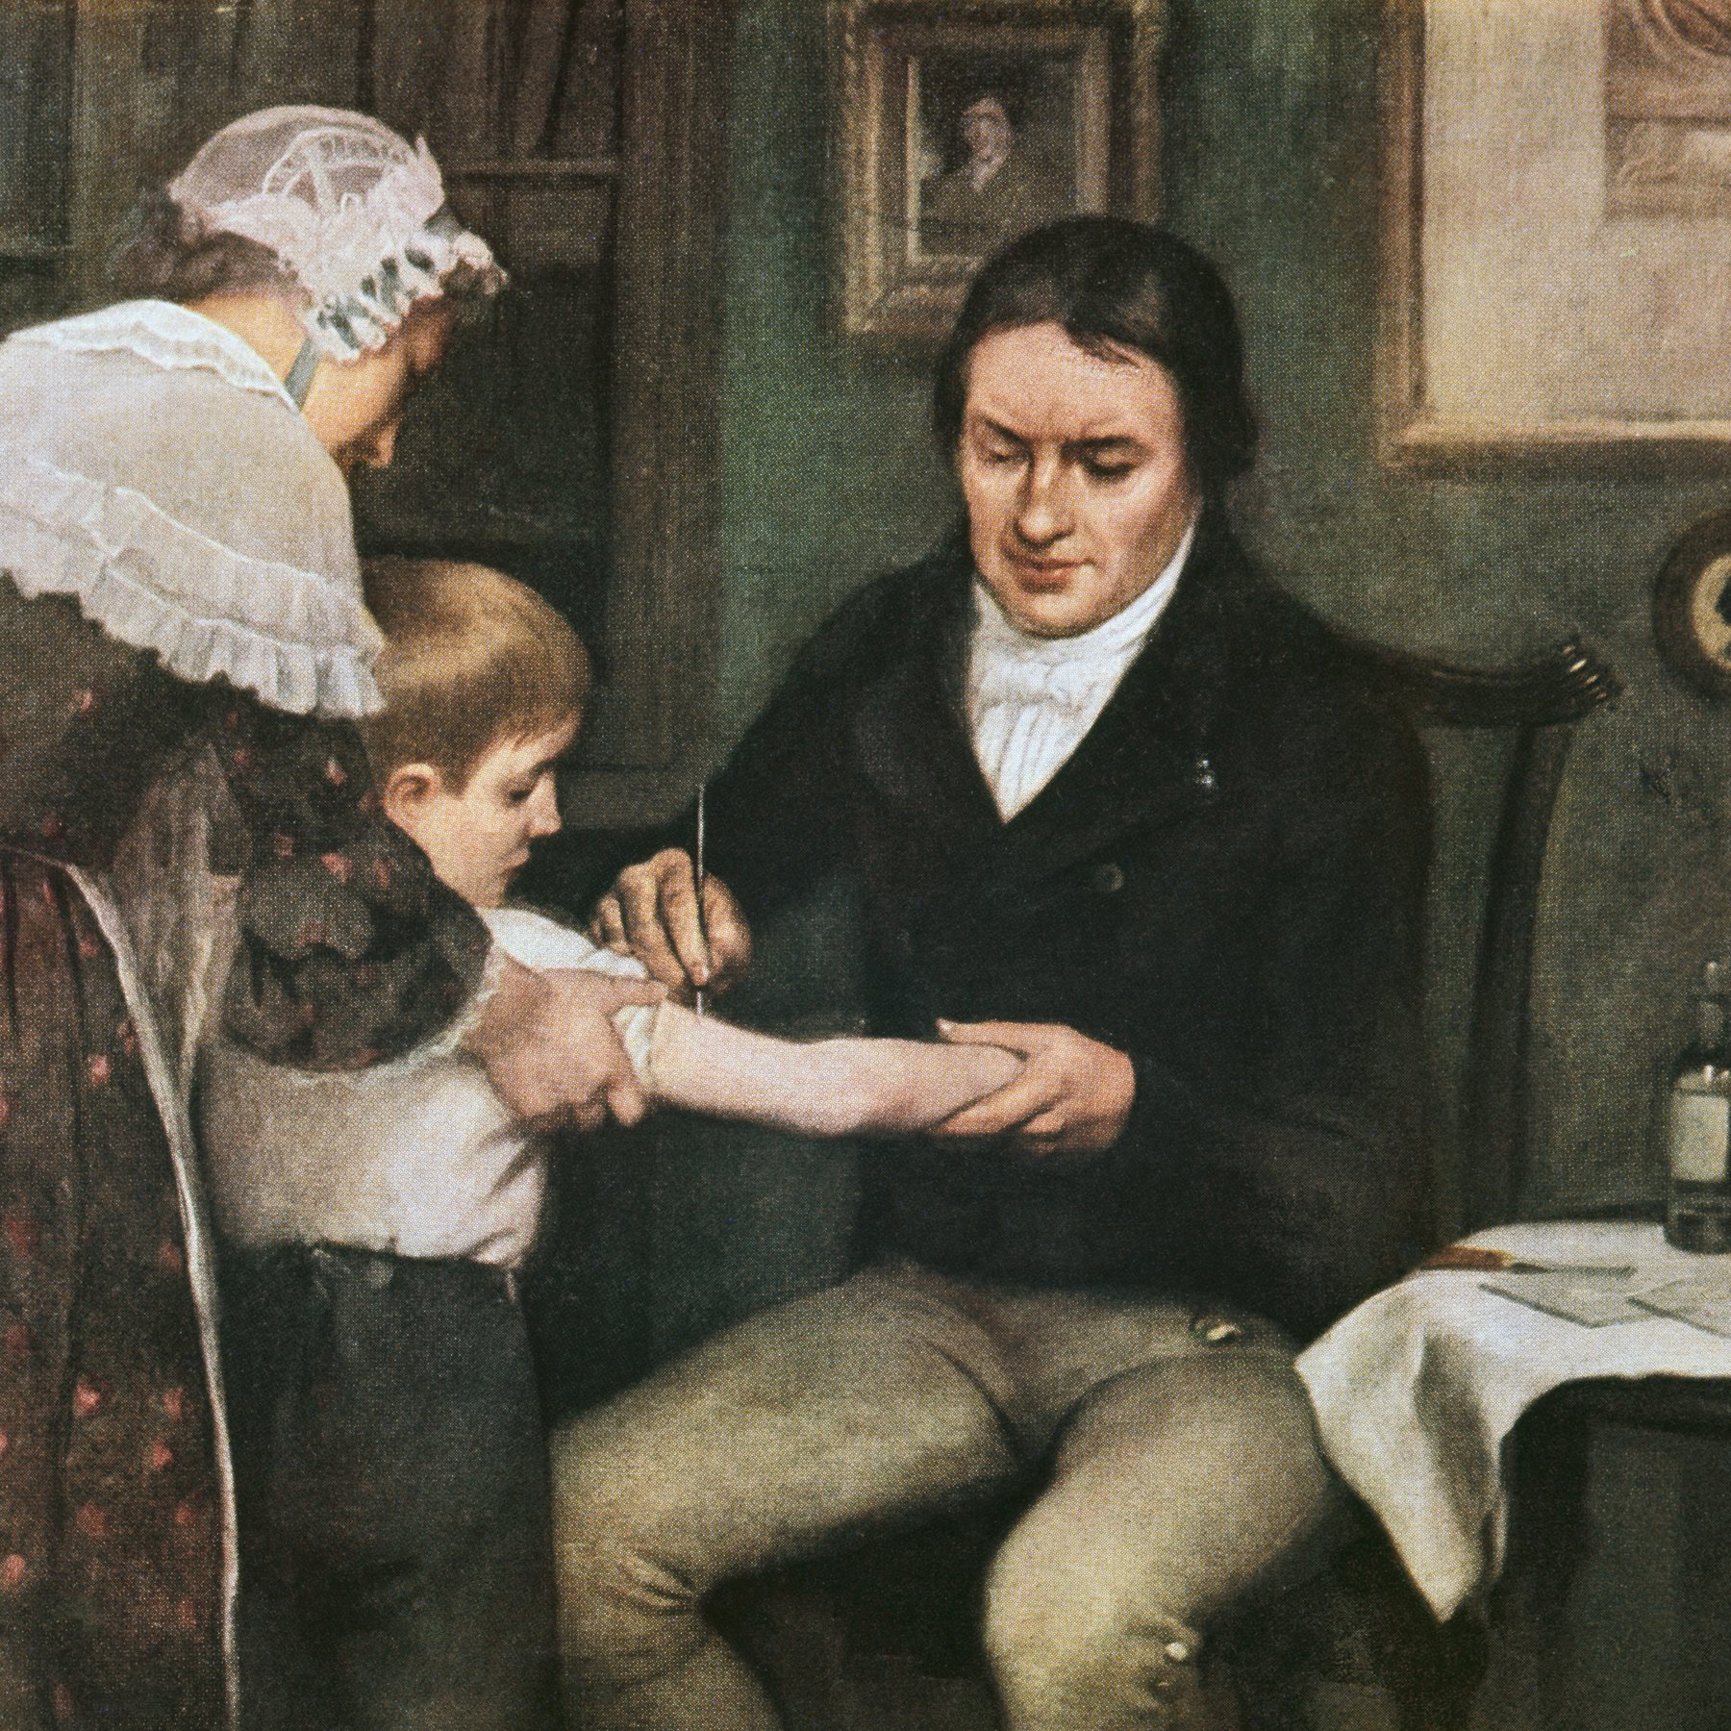
This man is associated with what disease?

Slide 5
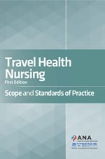
Travel Health Nursing: Scope & Standards of Practice
Understanding what’s inside the cover & what it means for you

Slide 6
What Inspired Us?
ATHNA mission when incorporated in 2004
Experience with patients: no consistent approach
Evidence of malpractice, noncompliance with CDC, state nurse practice acts
Essential criteria of all other nursing specialties: ANA, AAOHN, etc.
Mounting requests from THNs, some employers
Part of a 3 Step Goal: Recognition/ Standards/ Certification

Slide 7
How Did ATHNA Achieve Success?
Starting in 2011, an ad hoc team was assembled consisting of foundational ATHNA expert members to begin work to define a scope and standards.
All members were assigned to review another specialty’s ANA-approved scope and standards and THN job descriptions
The core group met in person 4-6 times per year.
We established a relationship early with Carol Bickford of the ANA, who was our content editor / technical advisor.
In 2018, after multiple revisions, the document was sent out for public review as well as a first ANA Standards Review Board review.
After several high-level reviews, the ANA recognized the specialty and approved our Scope & Standards- leading us to today: our book launch!

Slide 8
Scope & Standards: Why Important?
ANA definition: Scope and Standards is a guide for carrying out nursing responsibilities in a manner consistent with quality nursing care and ethical obligations of the profession. Originated to protect the public from unsafe and unlicensed practice.
What does this mean for the Travel Health Nurse (THN) today:
- legal foundation for the specialty
- provides official definition of the specialty
- promotes health and safety of travelers
- helps the nurse provide individualized, consistent patient care
- assists THN with goal-setting for ongoing skill development and education
- helps define employer and public expectations
- required for specialty recognition and certification

Slide 9
Name this destination

Slide 10
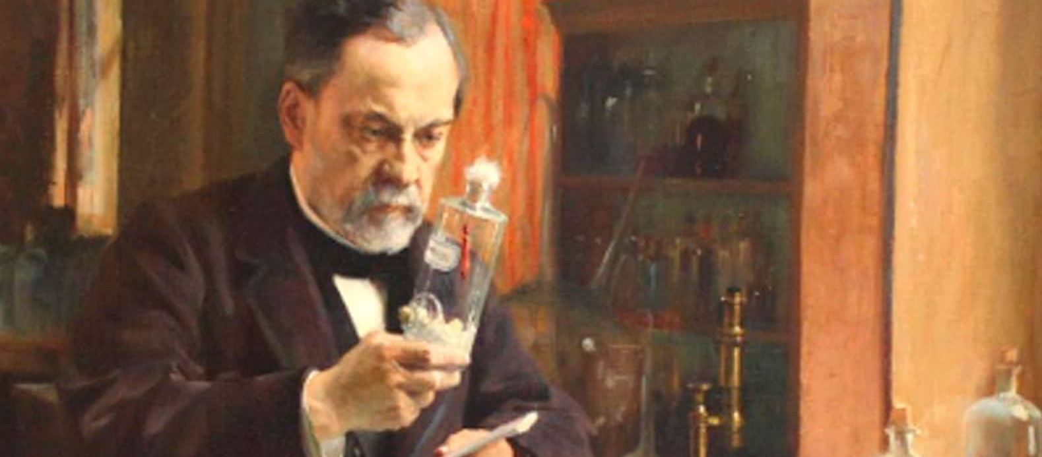
What vaccine did he develop?

Slide 11
What’s Inside?
History of ATHNA and Travel Health Nursing Standards Development
Scope of Travel Health Nursing: The Who, What, When, Where, How, Why
17 Standards:
Travel Health Nursing Practice
Professional Performance for Travel Health Nurses
Code of Ethics
Adaptation of Benner’s Model for Competencies, Professional Development
Glossary
12 pages of definitions and acronyms commonly used in travel health
Official Definition of the Specialty:
“Travel health nursing is the specialized nursing practice that advances the well-being of all travelers in all phases / stages of travel and in all settings.”

Slide 12
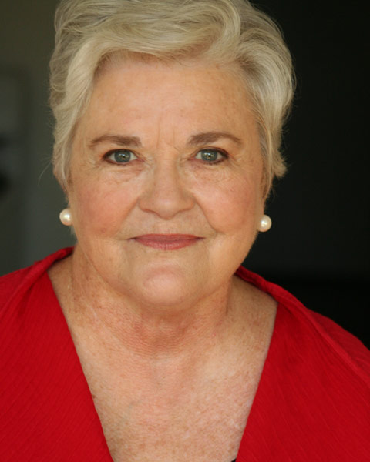
What is the Professional Development Model for THNs Based on Benner ?
Clinical ladder program derived from model created by Dr. Patricia Benner, nursing theorist
Serves as a model for the development of THN clinical competence, professional advancement
Five Stages of Clinical Competence for the Travel Health Nurse:
Novice level: New to Travel Health, needs careful ongoing supervision and active mentoring
Advanced beginner: Some experience with more complex travelers; needs less direct supervision with uncomplicated traveler encounters
Competent: Fully meets all minimum competencies for the specialty; provides quality pre-travel care in accordance with standards without supervision
Proficient: Anticipates with confidence the need to modify routine approaches to pre-travel care for a wide variety of travelers. See situations as “wholes” rather than parts
Expert: Has a deep understanding of the specialty; an intuitive grasp of travel health issues; flexible and proficient. Looked to be peers as the clinical authority
Benner, P. (1984). From Novice to Expert: Excellence and Power in Clinical Nursing Practice. Menlo Park, CA: Addison-Wesley

Slide 13
Why a Code of Ethics?
The essential foundation that informs everything we do professionally
While conflicts of interests are pervasive – our Code of Ethics
Provides guidance and illuminates the path forward in all situations
Helps make nursing a standout among all the professions
Protects our “brand” as the most trusted profession – 19 years running

Slide 14
Another Resource: academic.oup.com/jtm/article-abstract/28/1/taaa202/5958488?redirectedFrom=fulltext

Slide 15
Acknowledgements “ANA is pleased to recognize the specialty status of this essential area of nursing practice,” said ANA President Ernest Grant, PhD, RN, FAAN. “It’s a privilege to play such a vital role protecting the public and ensuring nursing practice maintains the highest and relevant clinical, research and educational domains. Granting this specialty recognition underscores the importance of nursing’s contribution to the global impact of travelers’ health and safety.”
Task Force of Expert Authors: ANA Technical Advisors:
Sue Ann McDevitt Carol Bickford
Julie Richards Erin Walpole
Mette Riis
Elaine Rosenblatt
Candace Sandal
Sandy Weinberg
Gail Rosselot, Chair
And our sincere thanks to the many
members and travel health stakeholders who
encouraged and supported this multi-year project!
www.nursingworld.org/nurses-books

Slide 16
Why is CDC located in Atlanta?

Slide 17
In what year was ATHNA incorporated?

Slide 18
Questions about the Scope & Standards?
info@athna.org

Slide 19
What is the #1 Cause of Traveler Death?

Slide 20
Introducing the 2021 Class of ATHNA Directors
Jane Chiodini, UK
Susan Cruz, Maine
Tammy Degenhardt, Wisconsin
Annie Horton, California
Amy Mannion, Indiana
Linda Sapio-Longo, Connecticut
Maureen Thompson, New Hampshire

Slide 21
Specialty Certification Draft Plan
By portfolio, not exam
Less costly
Credit for certificates, academics, CE
Experience requirement
PROPOSED PROCESS
Submit application with small fee
Review /Approval to submit required portfolio documents, full fee
Three- person expert review of portfolio
Approval with 3-year CE requirement
Renewal: duration- 5 years? 10 years?

Slide 22
Final Raffle Question: Where are we?

Slide 23
www.nursingworld.org/nurses-books

Slide 24
A Toast!
To Specialty Recognition
To the Scope & Standards
To You Our 2500+ Members
To achieving our 3- step goal: Recognition / Standards / Certification

